Slide 1
Fraud Detection Business & PM Project
Giuseppe Aniello badge: 643032
Edoardo Malaspina badge: 578355
Pietrangelo Manco badge: 550270

Slide 2
About Fraud Detection
The migration to digital payments comported an increase in digital crimes, so it has gained more importance the developing of new fraud detection techniques. In recent years most of those methods exploit AI technologies.

Slide 3
Project goal and Research Question
The research will focus on the topic of Fraud Detection
Sources | Used patents from AI_patents_2020_2021_claim - Google Drive, other patents from https://patents.google.com and some reviews from https://scholar.google.com
First Question | Who are the users of AI applications for Fraud Detection?
Second Question | What are the main topics and themes in documents related to Fraud Detection?
Third Question | Can you identify a trend in AI application for Fraud Detection?
Fourth Question | What are the State-of-Art AI techniques for Fraud Detection?
To view code link GitHub:
https://github.com/giuseppeaniello/FraudDetection

Slide 4
01
First Question
Who are the users of AI applications for fraud detection ?

Slide 5
Introduction
We analyze many patents, identifying the ones that are related to fraud detection using AI to discover who are the users of this technology, in particular we exploit NER.
Conclusion
Process Description
Technical Part

Slide 6
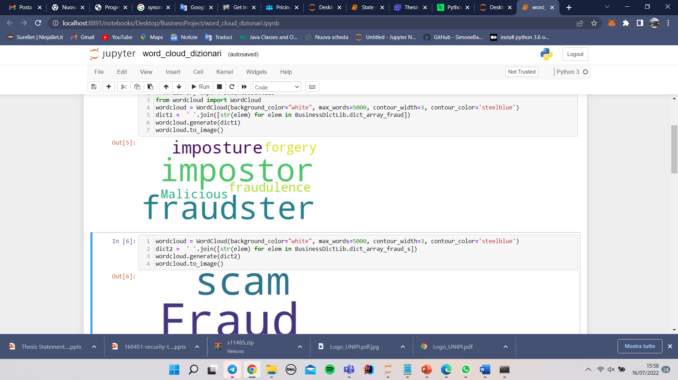
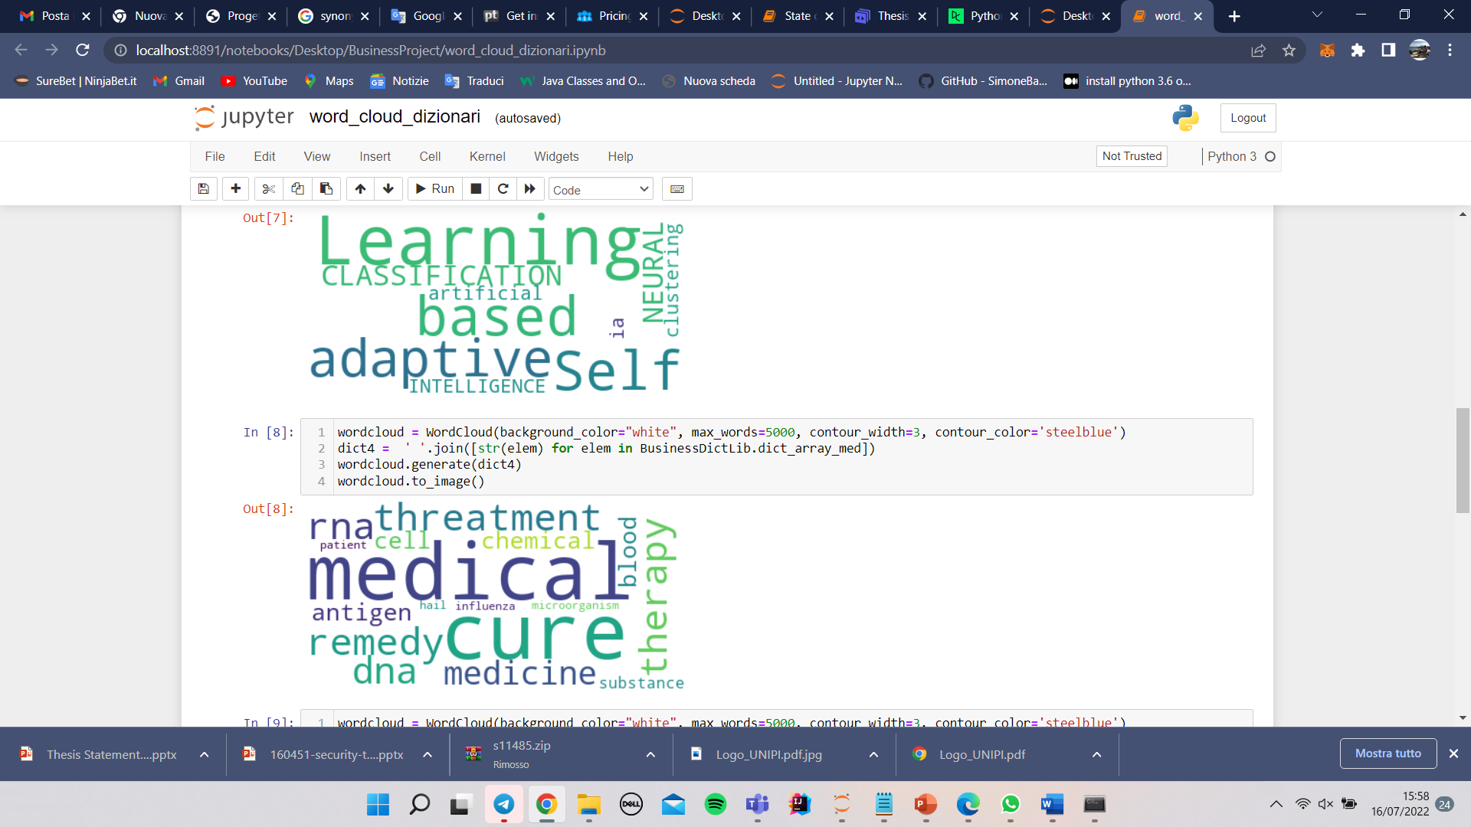
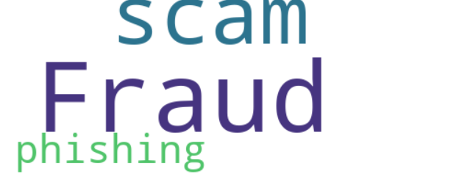
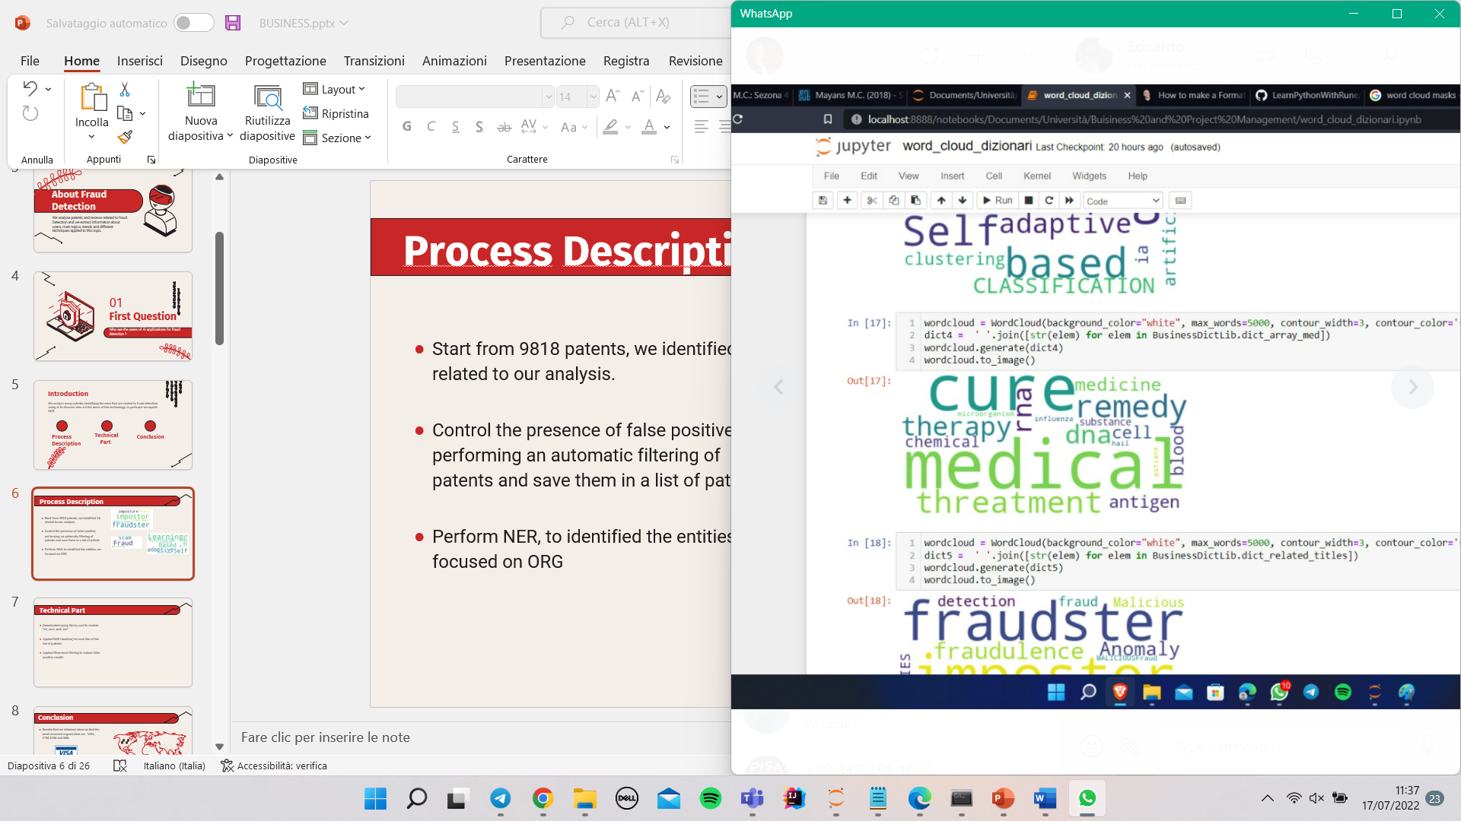
Process Description
Start from 9818 patents, identify 74 related to our analysis.
Control the presence of false positives, performing an automatic filtering of patents, exploiting dictionaries in our python library, and save them in a list of patents
Perform NER, to identify the entities, focusing on ORG

Slide 7

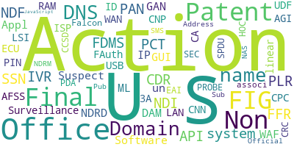
Technical Part
Downloaded spacy library and its module “en_core_web_trf”
Applied NER function() to each line of the list of patents.
Applied Stop-word filtering to reduce false positive results

Slide 8





Conclusion
Results obtained show that the most recurrent organization are : VISA, ATM, EVM and IBM.
Most common places resulting from our analyses are: USA, China, Japan and UK

Slide 9
02
Second Question
What are the main topics and themes in documents related to Fraud Detection?

Slide 10
Introduction
The aim of this analysis is to find the main topics of patents related to AI applications for fraud detection. This study is performed exploiting NLP techniques.
Conclusion
Process Description
Technical Part

Slide 11

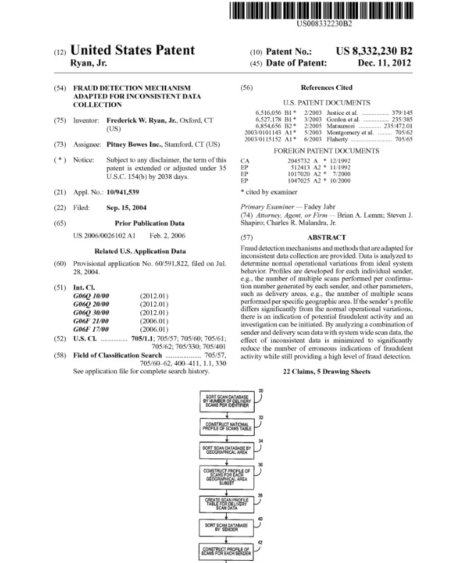
Process Description
Start from 9818 patents, identify 74 useful for our analysis.
Perform the same check of the first question.
Add 30 patents chosen by hand from google patents, in order to have a larger dataset.
Apply NLP techniques to find main topics.

Slide 12
Technical Part
Save useful patents in a list.
Apply preprocessing to data: lowering, removing whitespaces, tokenize, stop word filtering, pos tagging, lemmatization, stemming.
Plot results using wordCloud library to expose most frequent words.
Create an interactive map called ‘Intertopic Distance Map’.

Slide 13
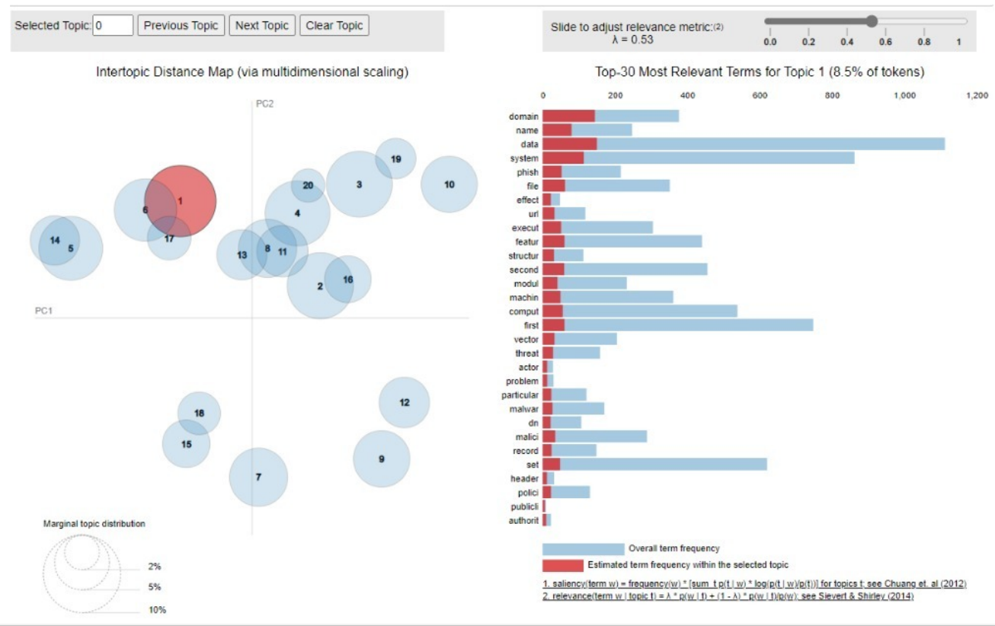
Conclusion
We notice that the dominating topic are IT related.
The most common key-words whitin topics are: Network, Phishing, Machine Learning, Regression, SVM, Bank Transactions, Fraud Detection, Systems’ vulnerabilities, Malwares, E-mails, Clusters, Cybersecurity, Online Games.

Slide 14
03
Third Question
Can you identify a trend in AI application for Fraud Detection?

Slide 15
Introduction
We analysed many patentes, identifying the ones that are actually related to fraud detection using AI to discover how this kind of technology evolved in the last years.
Conclusion
Process Description
Technical Part

Slide 16
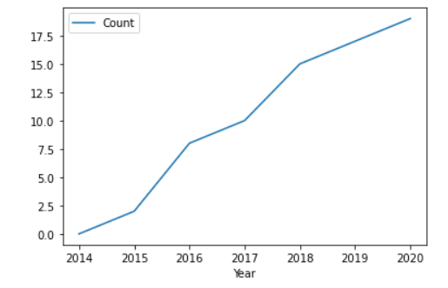
Process Description
Start from 9818 patents, identify 74 useful for our analysis.
Perform the same check of the first question.
Exploiting the structure of patents, identify the dates and divide in groups corresponding to each year.
Count the number of patents for each year.
Exploit NLP techniques to find most common words over the years

Slide 17
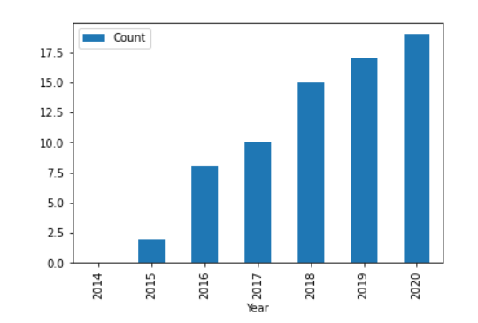
Technical Part
Saving patents and dates to find useful values
Plotting trend in time, counting the number of patents for each year
Merging patents per year, in order to consider the main topics for each year
Preprocessing of data: lowering, removing whitespaces, tokenize, stop word filtering, pos tagging, lemmatization, stemming and counting
Plot for each year the frequent words

Slide 18
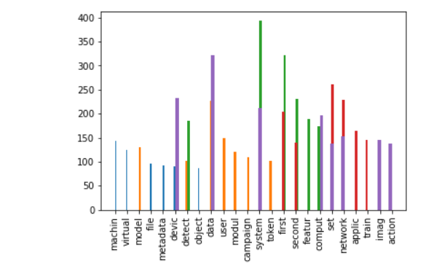
Conclusion
We noticed a clearly increasyng trend during the years from 2014 to 2020 of patents related to AI for Fraud Detection.
In particular we noticed in 2020 starts to appear as a frequent word ‘image’, from that we discovered that a new field of fraud detection is ‘Image Forgery Detection’

Slide 19
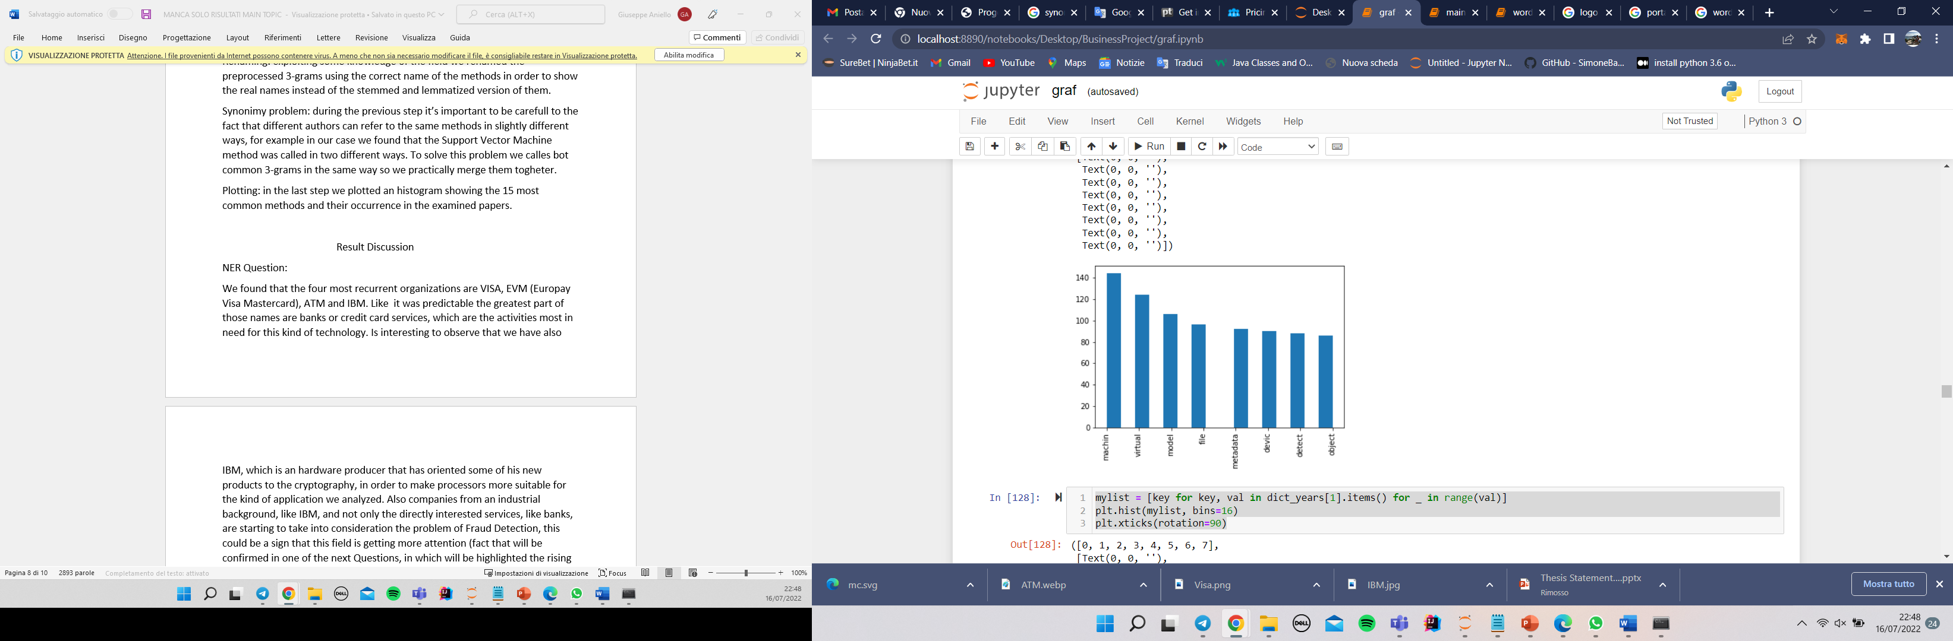
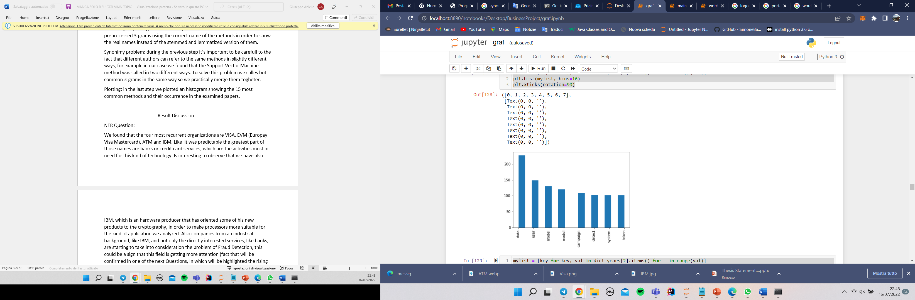
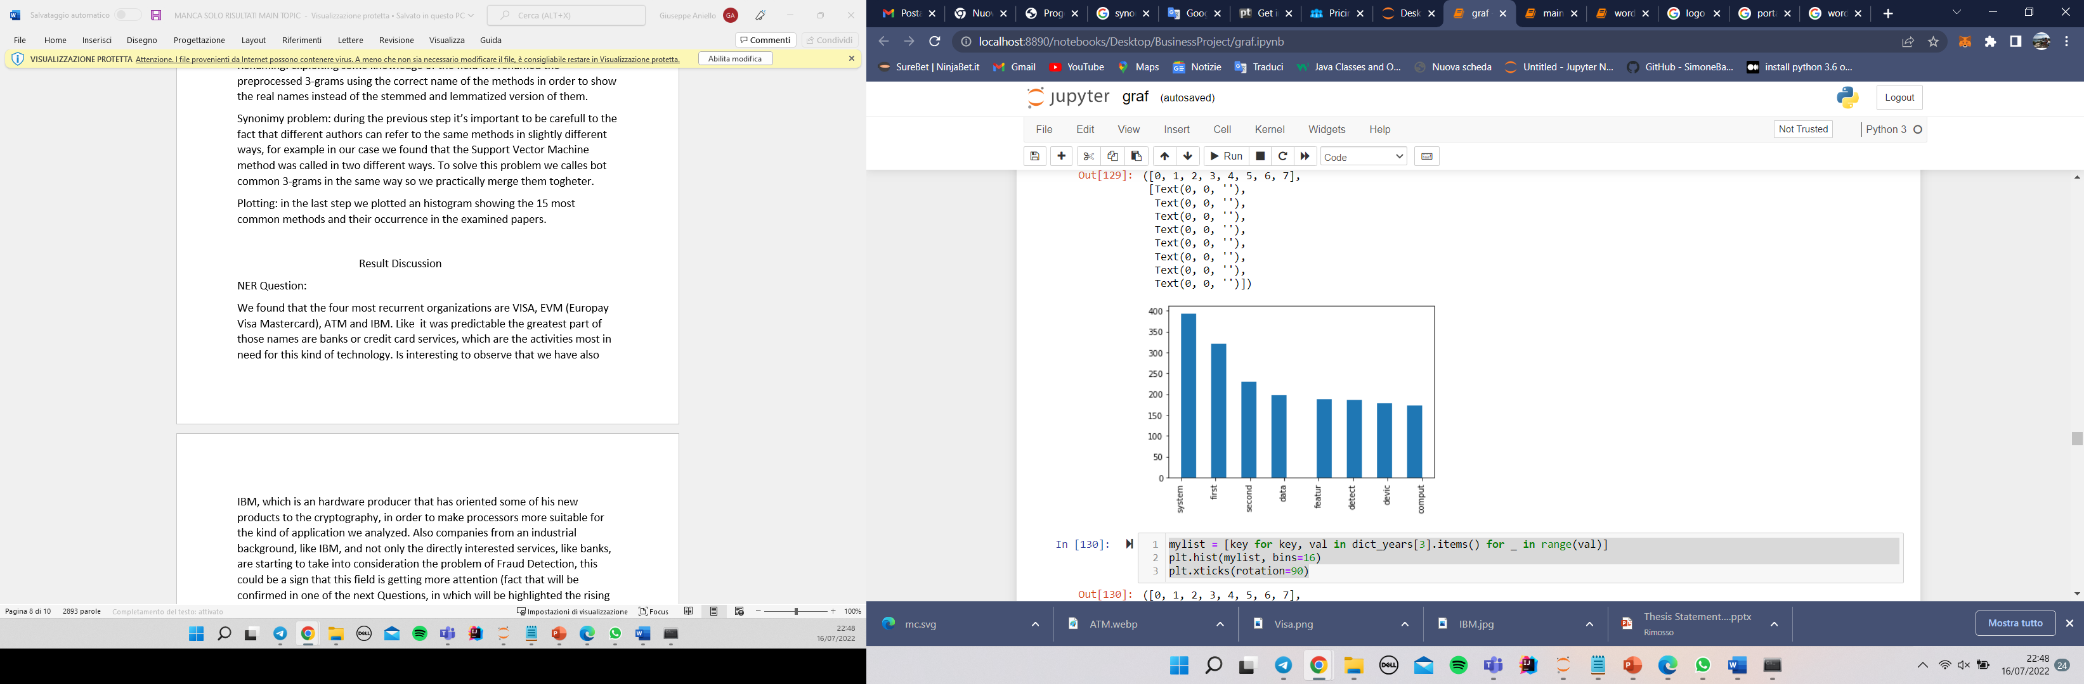
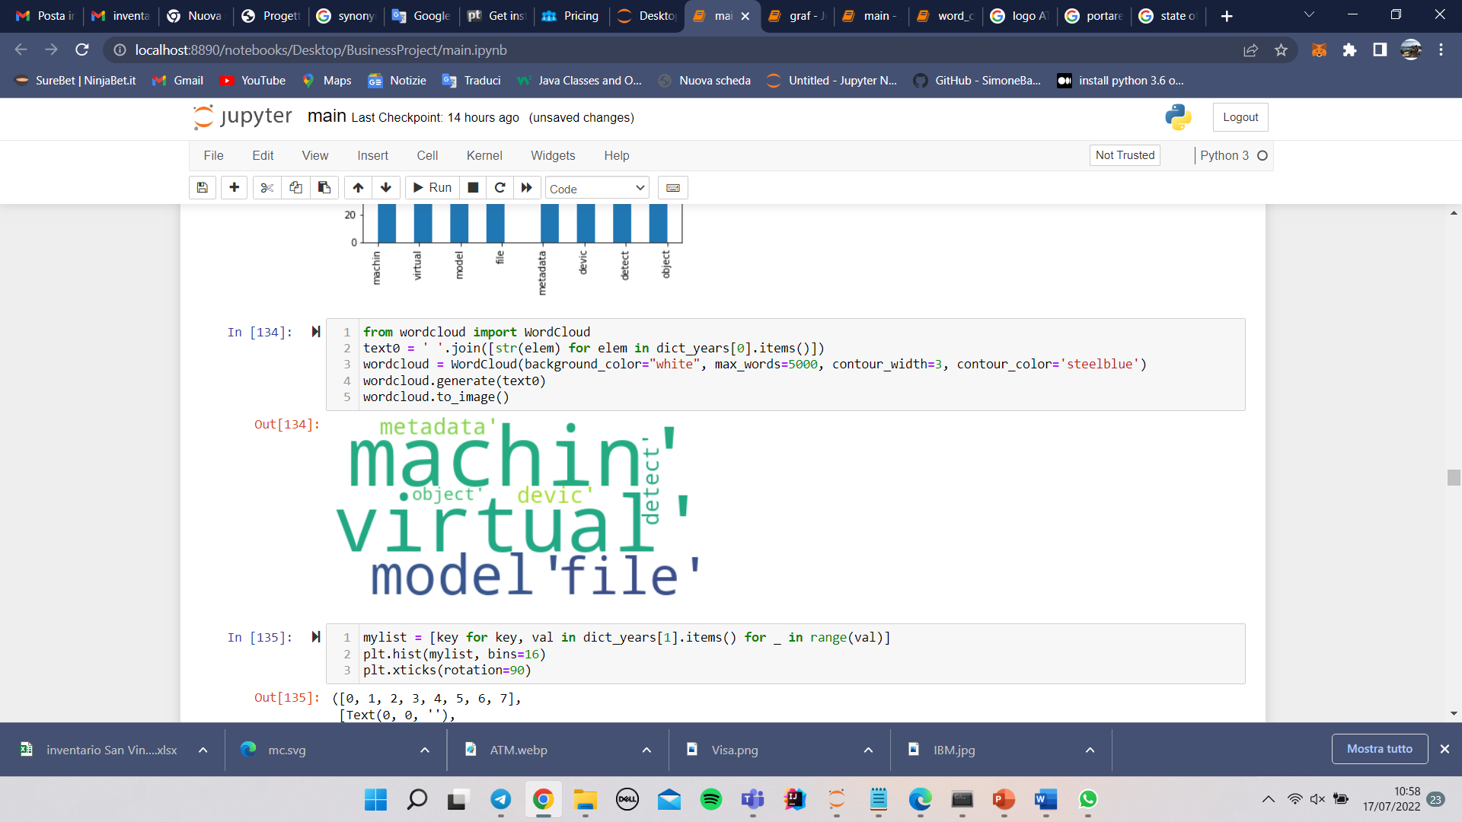
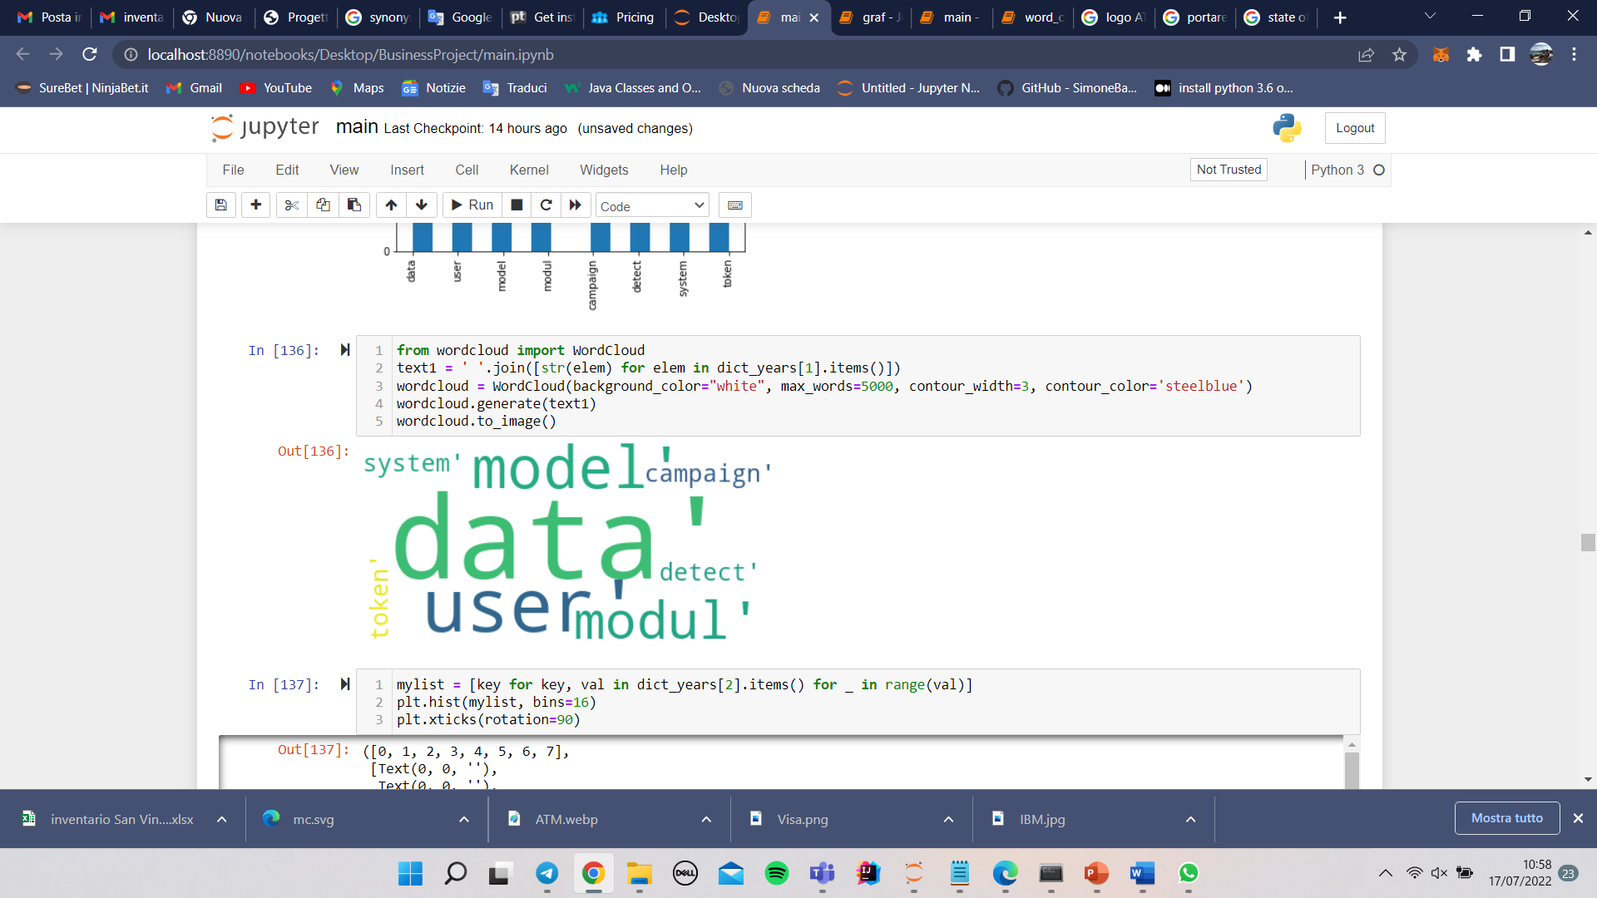
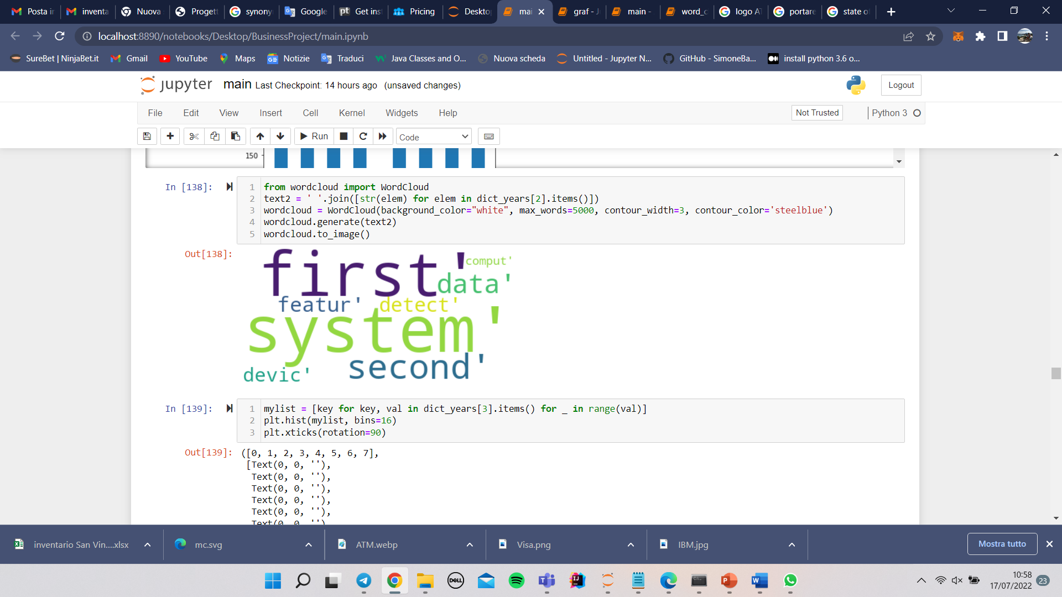

Slide 20

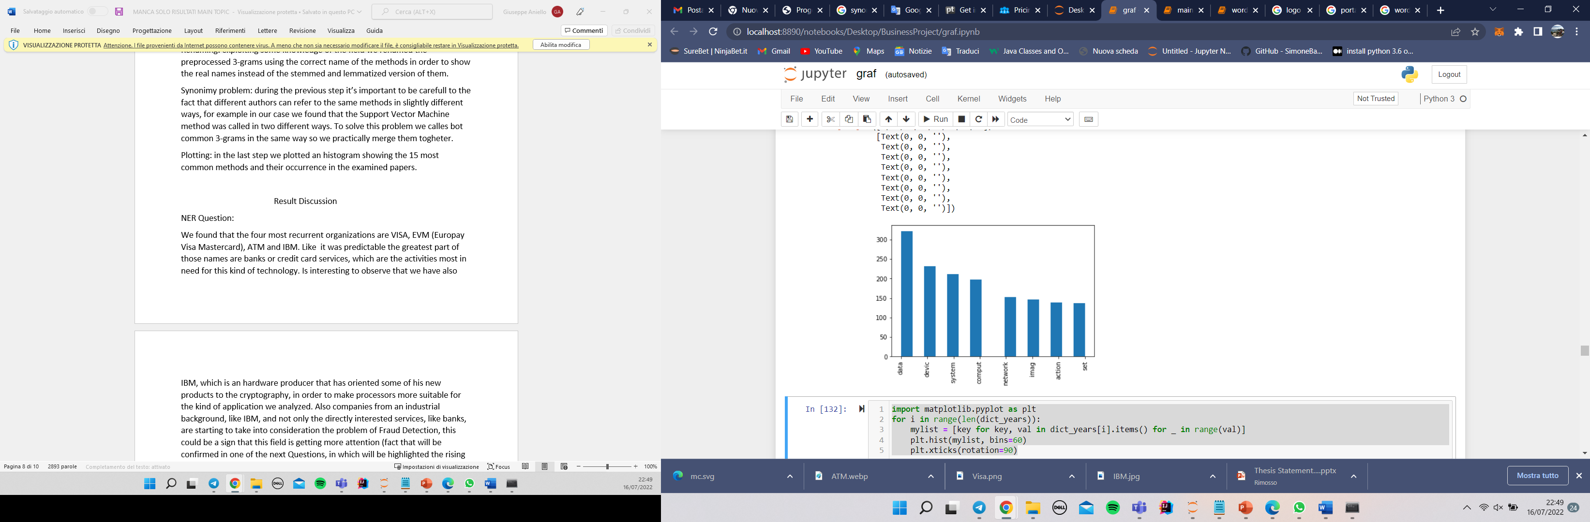
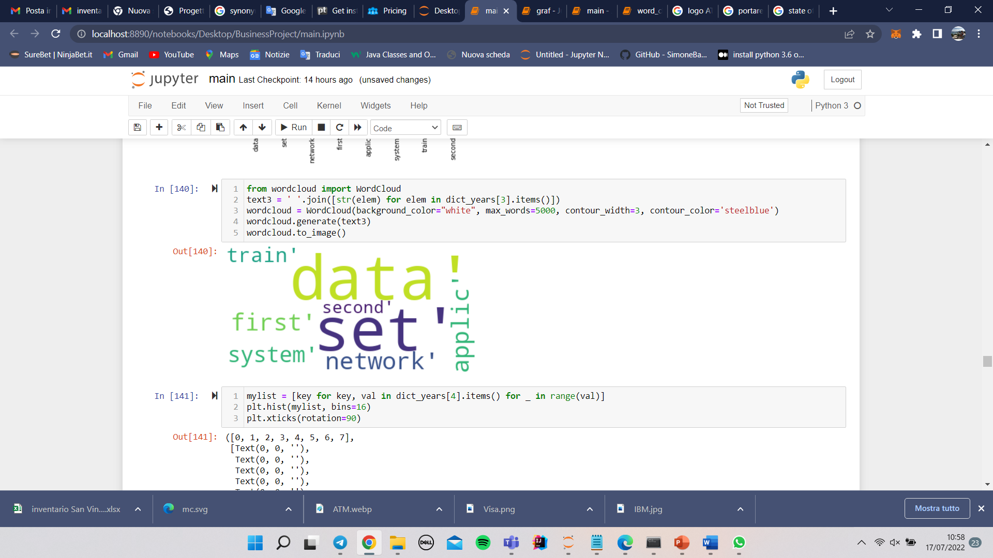
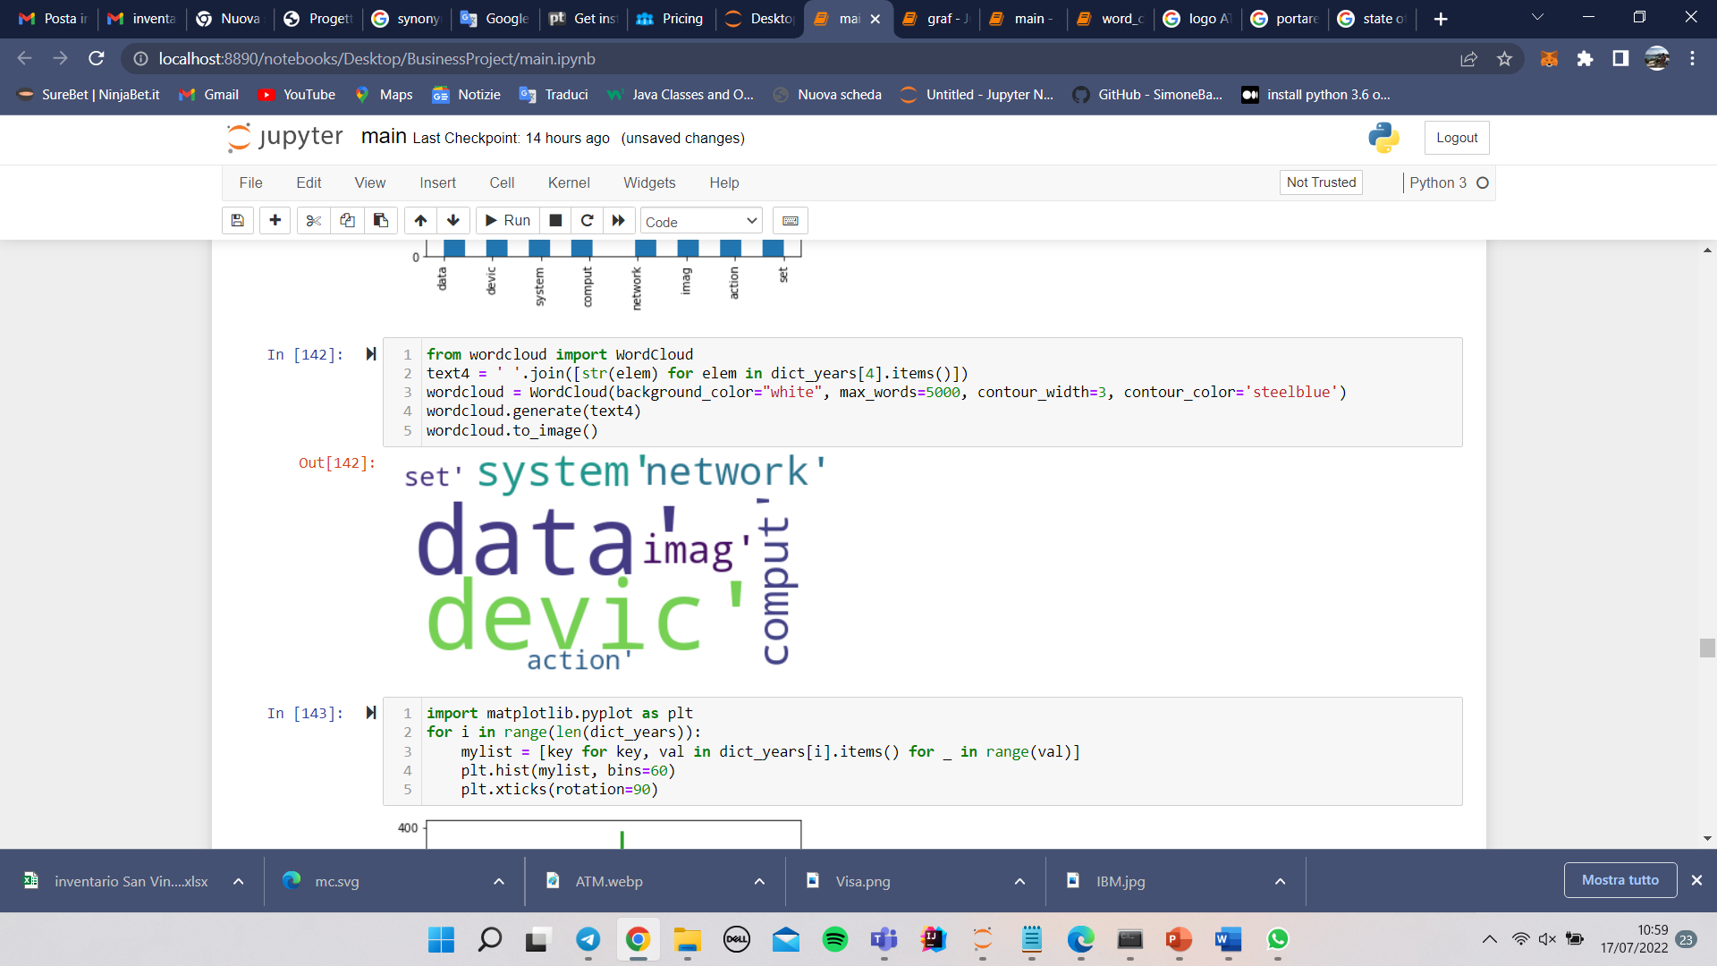

Slide 21
04
Fourth Question
What are the State-of-Art AI techniques for Fraud Detection?

Slide 22
Introduction
Exploiting NLP we tried to found most common AI methods that were used, to estabilish the most recognized State-of-Art methods among the time stamp of our articles.
Conclusion
Process Description
Technical Part

Slide 23

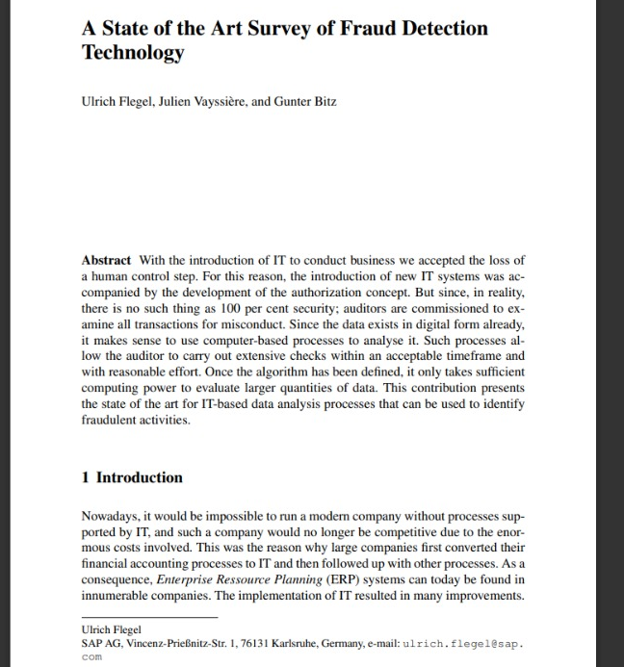
Process Description
NLP techniques have been applied to 33 surveys found exploiting google scholar.
Those surveys are all focused on the analysis of state of the art methods for fraud detection using AI
Exploiting NLP we found most common methods in those surveys

Slide 24
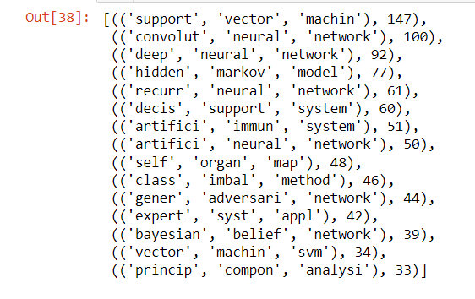
Technical Part
Start reading files downloaded in .pdf and saving them in a string. Finally merge all element into a single string
Preprocessing of data: Lowering, removing whitespaces, tokenize, stop word filtering, pos tagging, lemmatization, stemming, cleaning, counting
Found the common 2-grams and 3-grams and choose the 3-grams approach, we used ngrams module of nltk.
Plot an histogram showing the most 15 common methods
PROBLEM !!!
Synonymy problem, to solve this problem we called both common 3-grams in the same way so we pratically merge them together

Slide 25
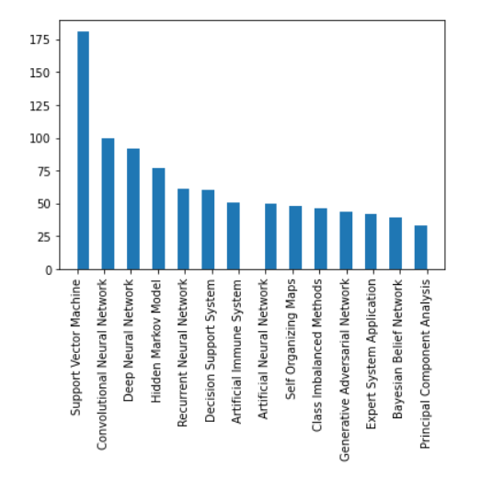
Conclusion
We found that in the field of the Fraud Detection many AI techniques are used.
The most common is the Support Vector Machine.
We can observe that different families of algorithms are used, both traditional machine learning methods and neural networks.
This kind of analysis can be useful to people that approach this field from a less technical point of view to easily find the most common methods.

Slide 26
Thanks for the attention!

